Slide 1

ATLANTA EXPO
July 14, 2022

Slide 2
The information contained in these documents is confidential, privileged and only for the information of the intended recipient and
may not be used, published or redistributed without the prior written consent of Le Creuset of America Inc..

Slide 3

AGENDA, July 14, 2022
Le Creuset Brand Updates: Le Creuset Marketing and Communication Updates
Business Review: YTD – Gourmet Catalog Store Shipping Results
Specialty Store Programs
2H Planning – New Products, Programs & Promotions

Slide 4
YTD-2022 SHIPMENTS: GC STORES – through June
Total GC 2021 Shipping Volume = $8,657.2M; +52%
Total GC 2020 Shipping Volume = $5,597.2M; +48%
IH – 2020 GC Shipping Volume = $2,042.7M
2022 IH = +80% over 2020 shipment volume

Slide 5
LE CREUSET
More Than a Dutch Oven

Slide 6




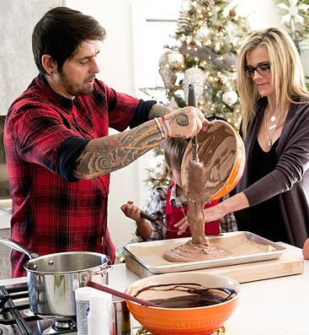
OUR BRAND FOCUS
LE CREUSET’S CORE TENETS:
Ensure that the heart of every home extends beyond the kitchen (mission statement)
Engage consumer through visually rich story-telling around our brand position and relationships
Build brand recognition through Marketing:
Content → Conversation → Credibility → Conversion
Partner with the most premium retailers (roughly 1/3rd of the Cookware marketplace)
Protect the brand with the strongest MMAP policy in the industry ensuring a fair playing field
Focus on Brand Truths - First in Color, Finest in Quality & Design and the Favorite for Generations
Notes:
the main principles that have allowed us to drive significant growth.
We stand by these Core Tenets and they will continue to be our focus in driving compelling value and sustainable growth with our partners

Slide 7
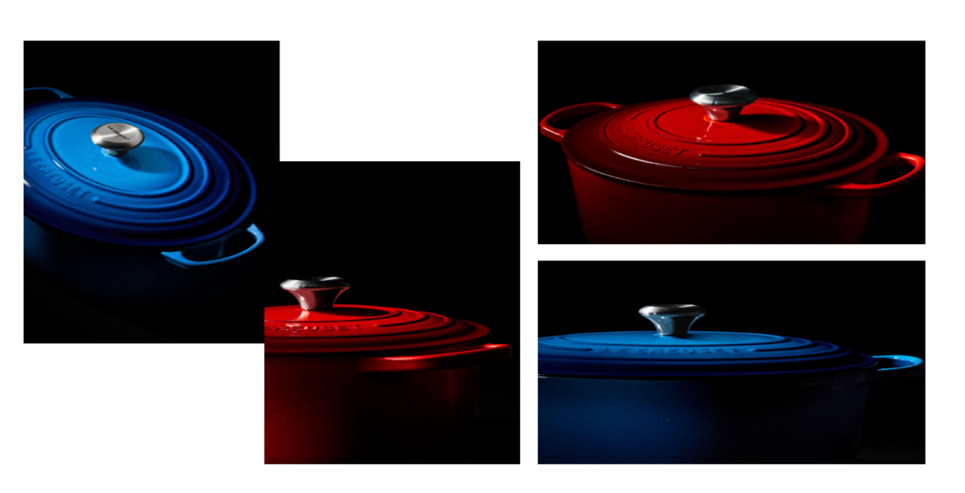
IMAGERY WILL HIGHLIGHT THE PHYSICAL FORM OF THE BRAND MARK

Slide 8
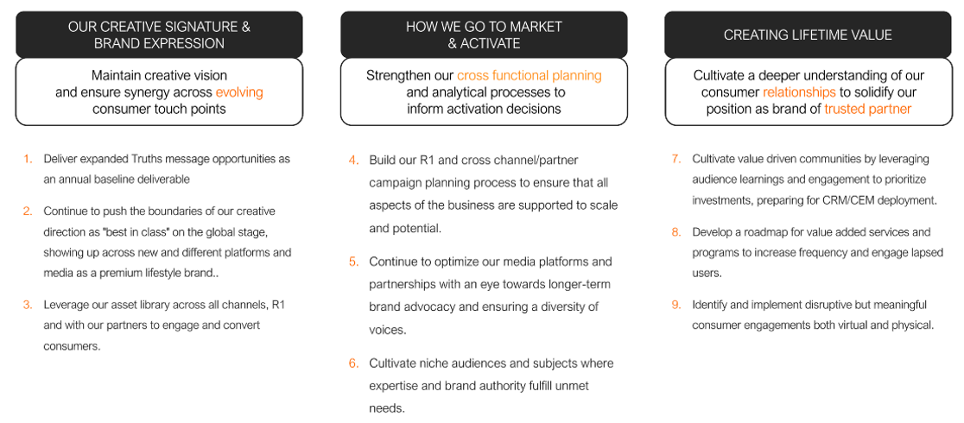

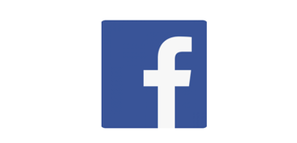


Over 1.4m Followers (all social channels)
60.2M​
TIKTOK Views #lecreuset (organic)
830,000
440,000
46,000
30,000
EARNED MEDIA IMPRESSIONS
FY 2021 TOTAL
103 Billion (up 32% vs LY)
2x all other cookware brands combined
*FY 2020 = 78BB (13x total 2019, 6.0BB)
Earned media consists of all the content and conversation around our brand and products that has been created and published somewhere other than our owned channels (includes press coverage, social media mentions, shares and retweets, product and/or reviews, and blog posts authored outside our company)
Notes:
We have always been a Marketing these 3 Pillars at the top… (1. develop consistent messaging and brand representation wherever we are sold… 2. look at the data (CRM) and have the right focus on where we invest… 3. make it sustainable
2x more impressions than all other cookware brands combined!
WE ARE INVESTING and the ROI is proven… TAG US!

Slide 9
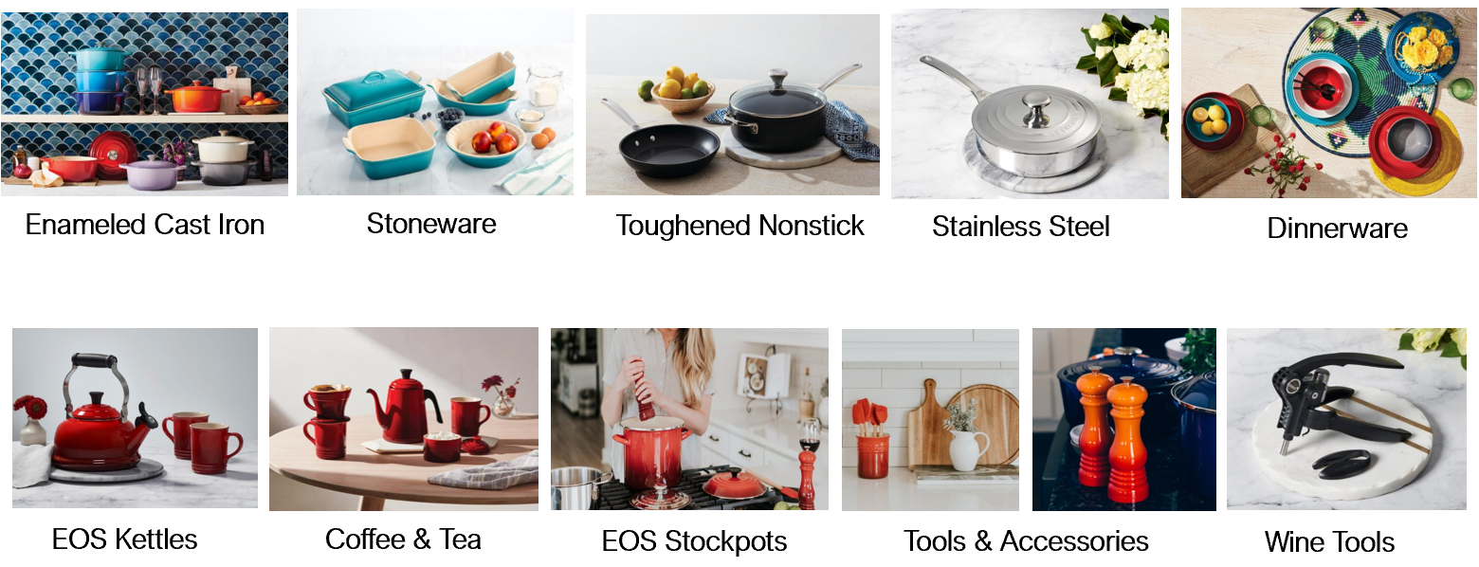
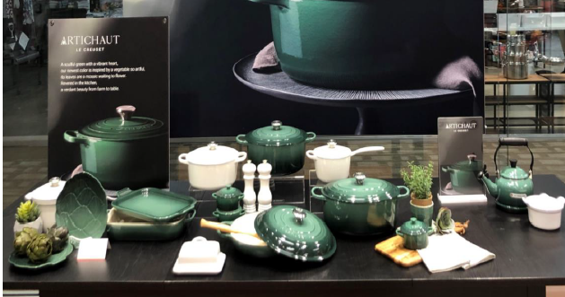
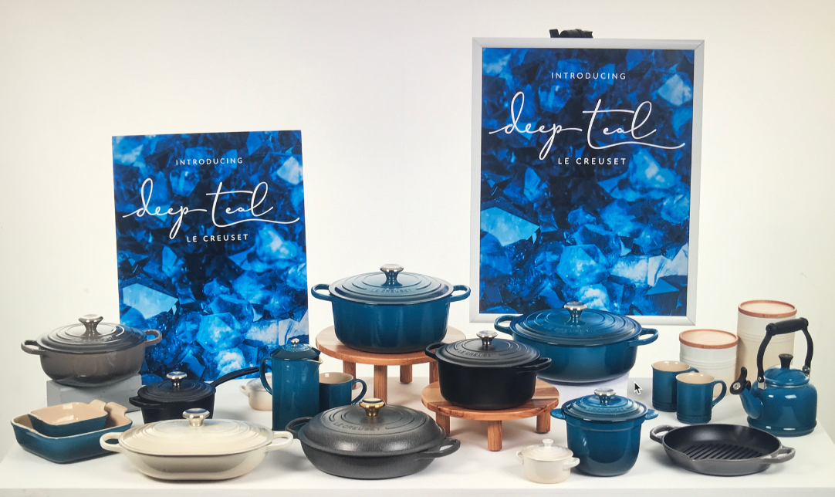

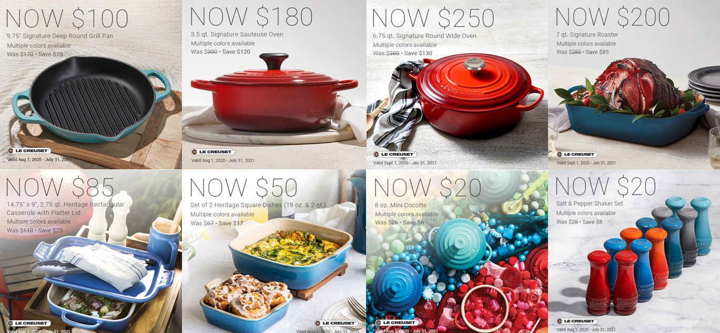
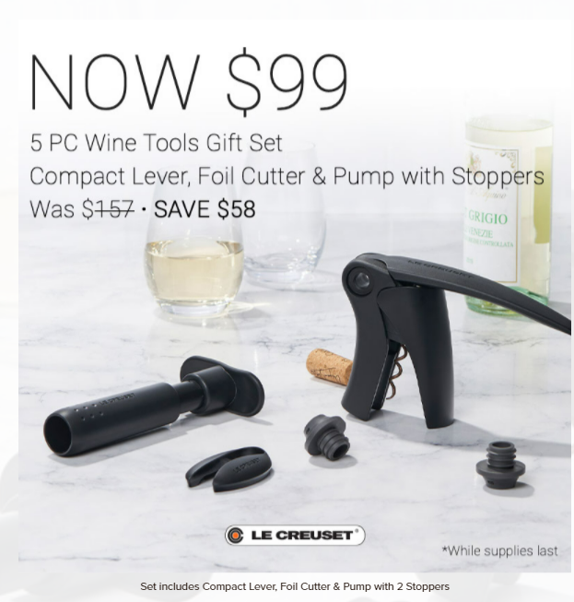
BRICKS: Enhancing In-Store Experience (B&M)
BRICKS: In-store Brand Experience
Assortment/In-Stocks
Tell a story with a full representation of Le Creuset Colors, Categories and Solutions. Maintain in-stocks
Display
POP, Sales Materials, Merchandising kits and Signage
Promotion
Assets/Signage - Specials, GWPs Bundles, Sets
Events (demos, trainings, etc.)
Drive traffic, create brand excitement

Slide 10
Premium Merchandising/Shop-in-Shop Program
June 2022 and Beyond

Slide 11
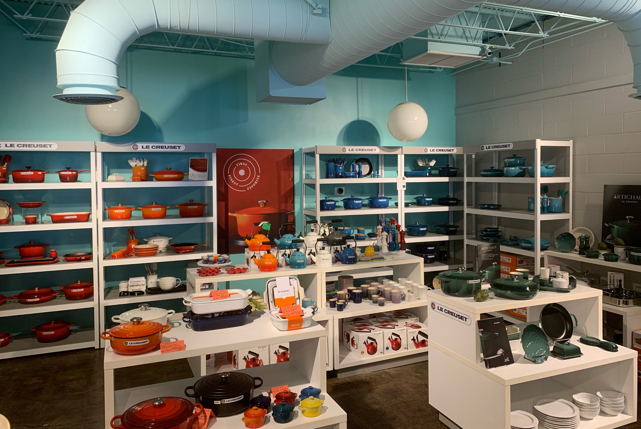
PREMIUM MERCHANDISING/SHOP IN SHOP PROGRAM
Objective: Strategically identify 10-12 new Independent Shop-in-Shop retailers in 2022 where we know we can gain incremental shelf, floor and window space, add new categories, drive consistent brand messaging and increase turns.
Parameters: Each sales manager must evaluate the accounts in their territory and determine which can meet the following expectations:
The account must:
Allow for minimum 300 dedicated sq ft for Le Creuset retail space
Show consistent revenue growth over the past three years, supported by sales data
Maintain a minimum of five colors and five categories (What categories could be added?)
Maintain good credit status
Always be UMMAP compliant
Follows Le Creuset’s online expectation guidelines (if applicable)
Have an Omni-channel approach w/ digital footprint in addition to brick & mortar
Le Creuset brand advocates:
Digital presence utilizing LC assets
Social presence and engagement utilizing LC assets and Social Press Kit
Visual displays that align with commercial objectives
Utilization of applicable launch kits (i.e. new color, category, etc)
Use of general merchandising guidelines
Educational offerings such as cooking classes, demos, etc.
New Request Form (attached). Sales manager to provide a plan that meets parameters.

Slide 12
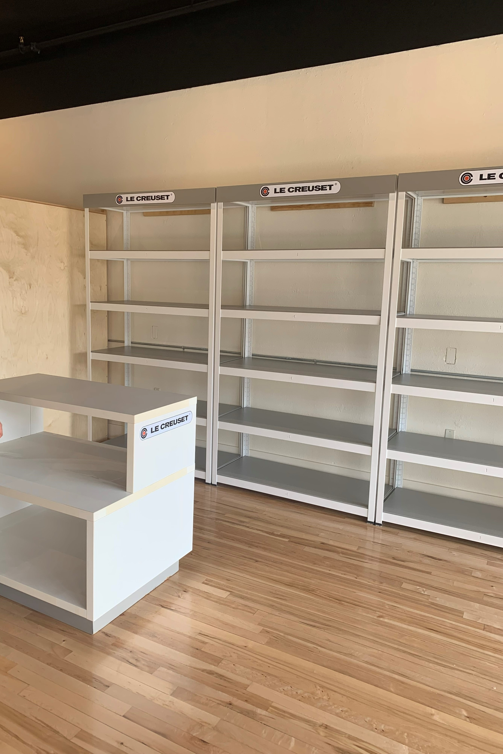
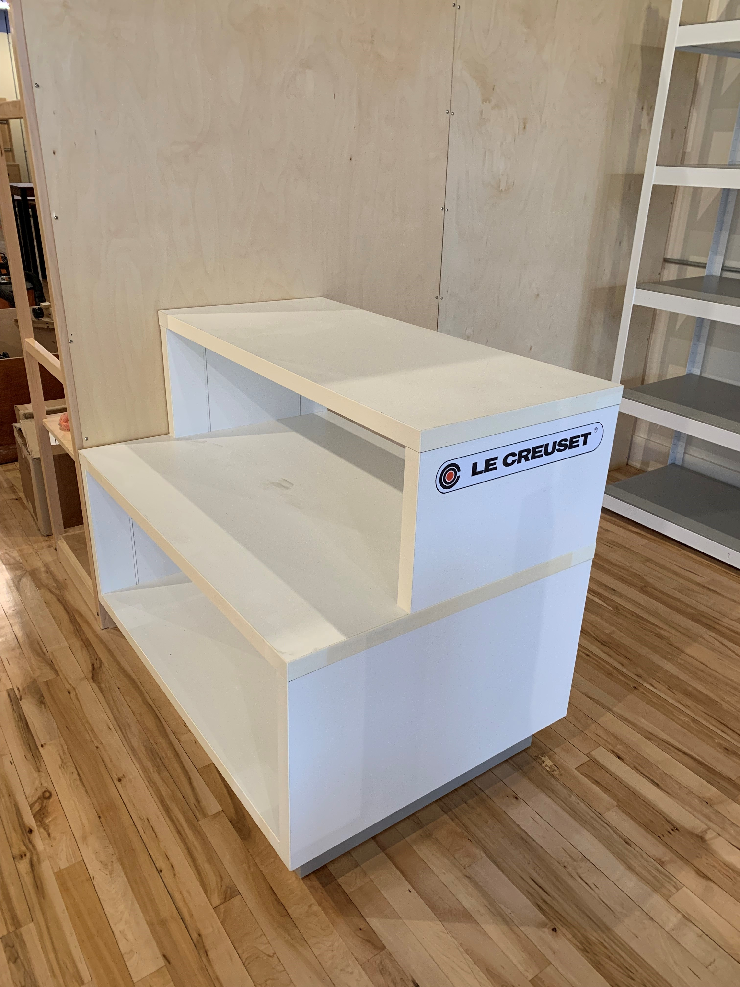
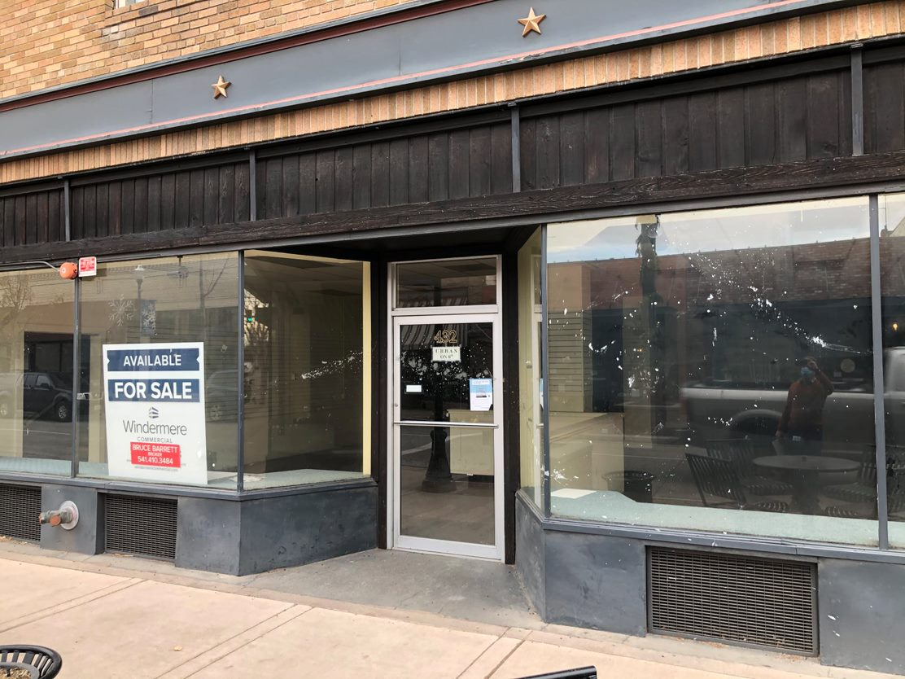
SHOP-IN-SHOP: AROME – SPRING 2022: Before

Slide 13
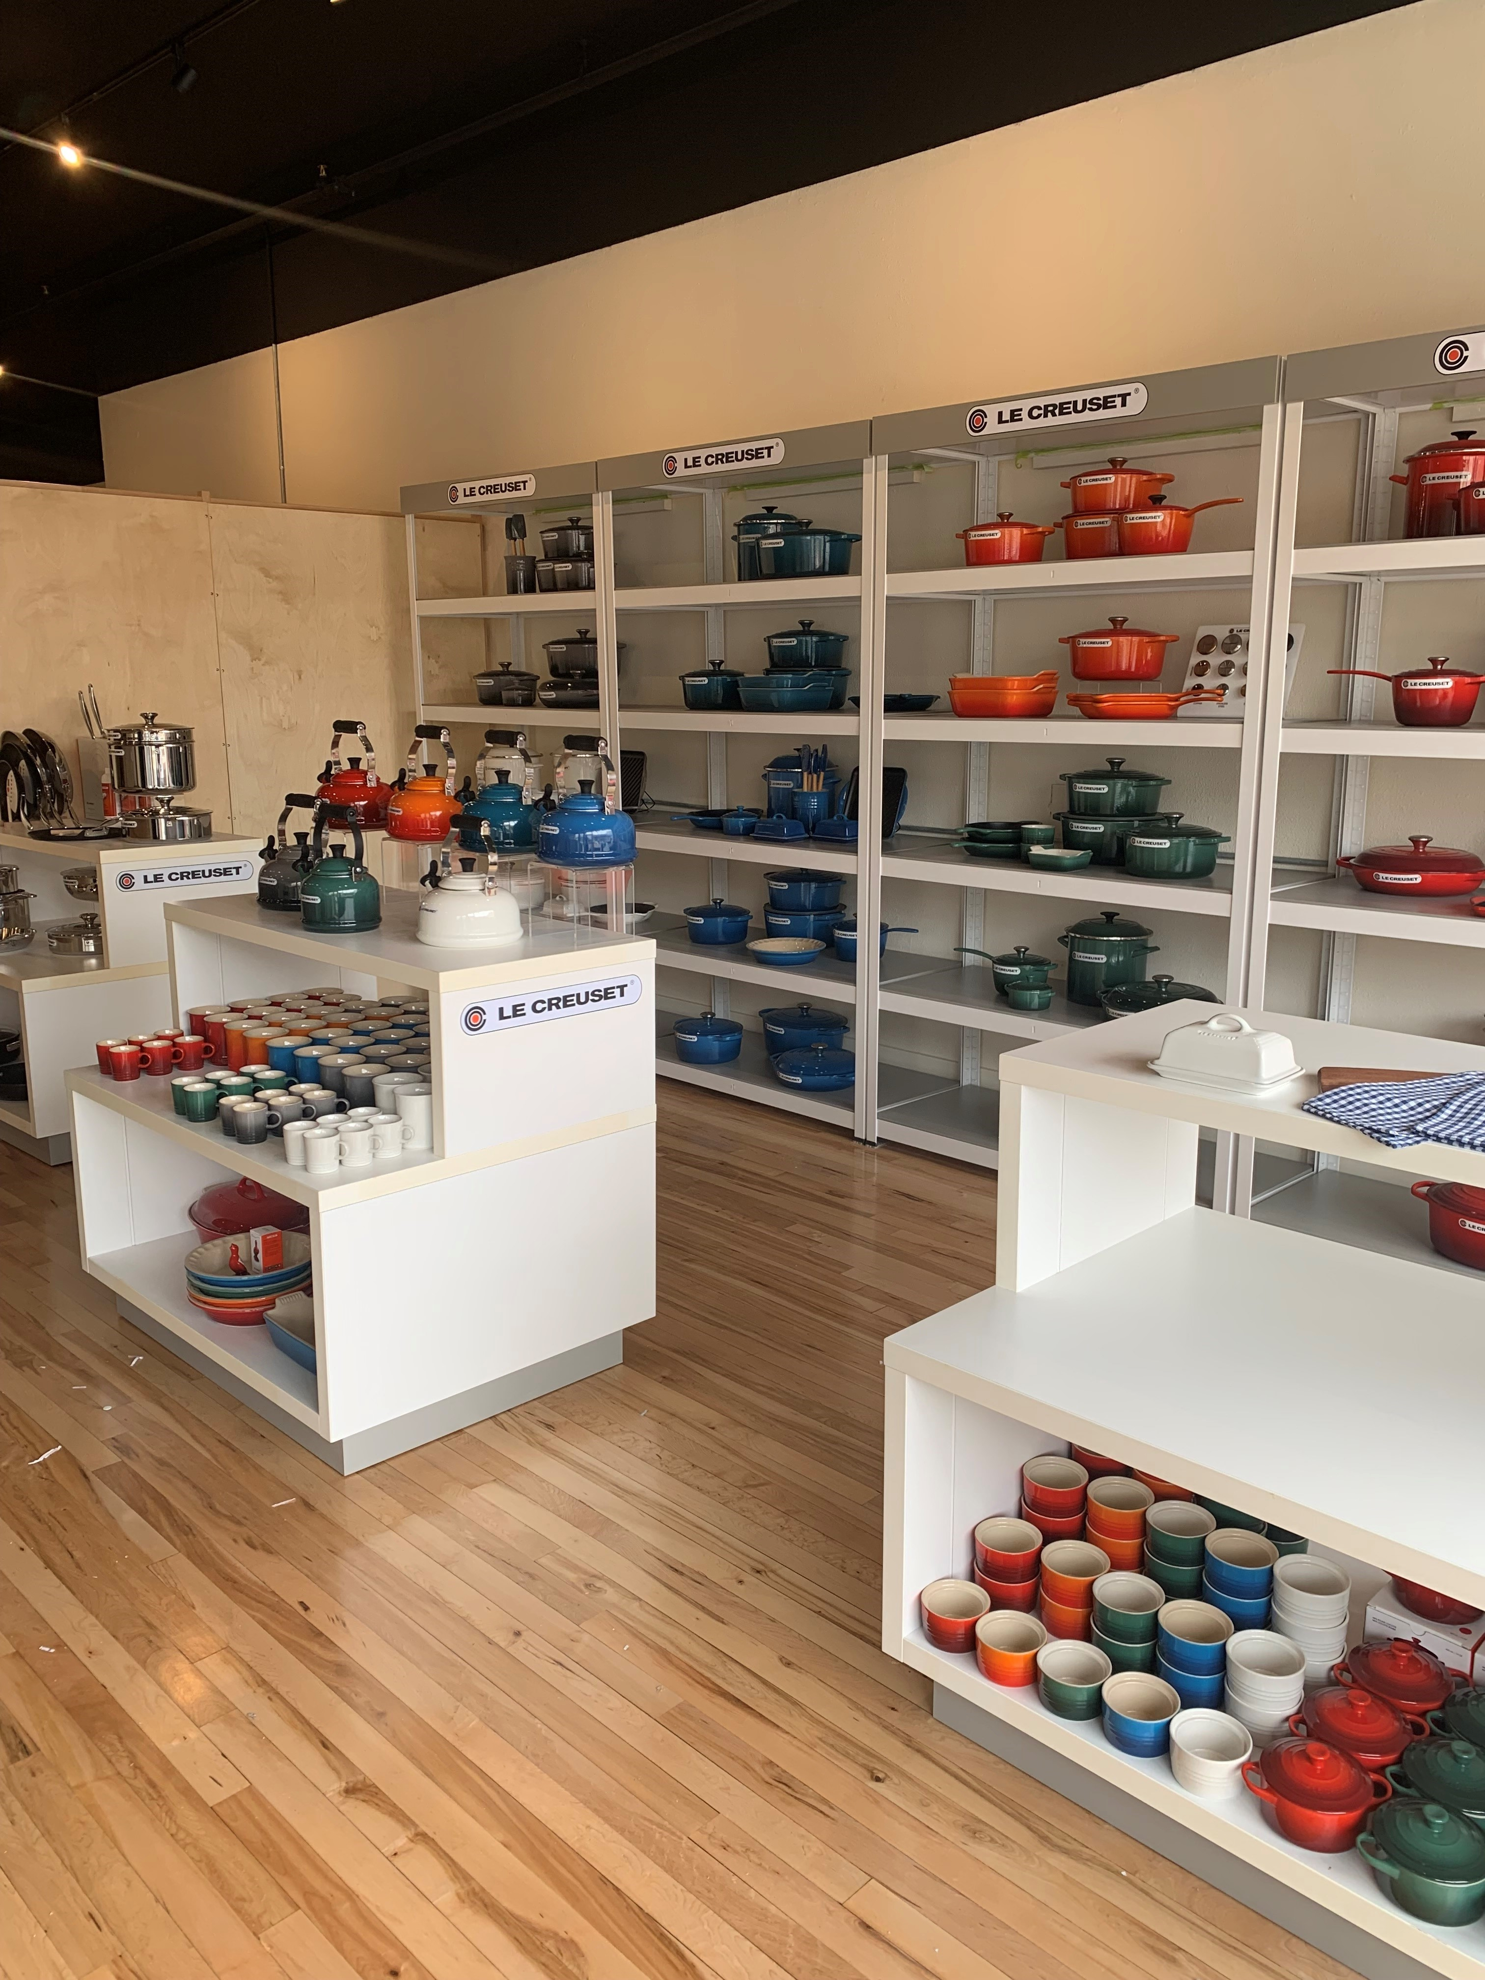
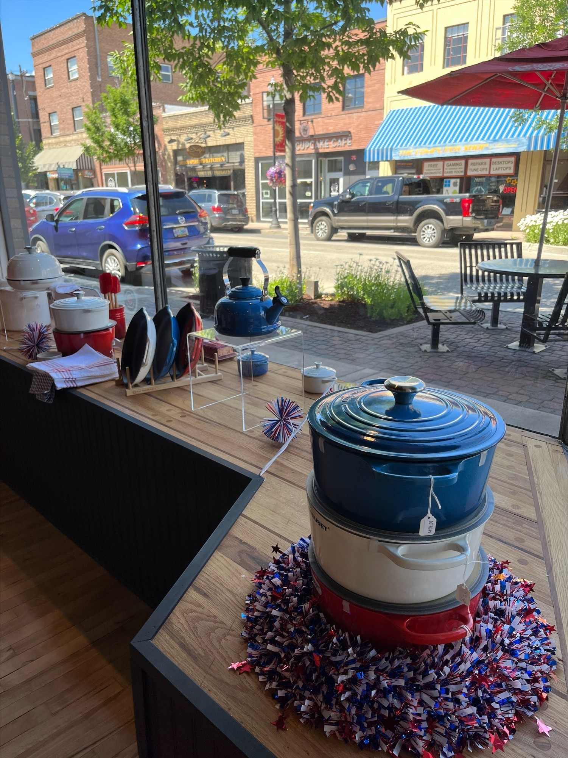
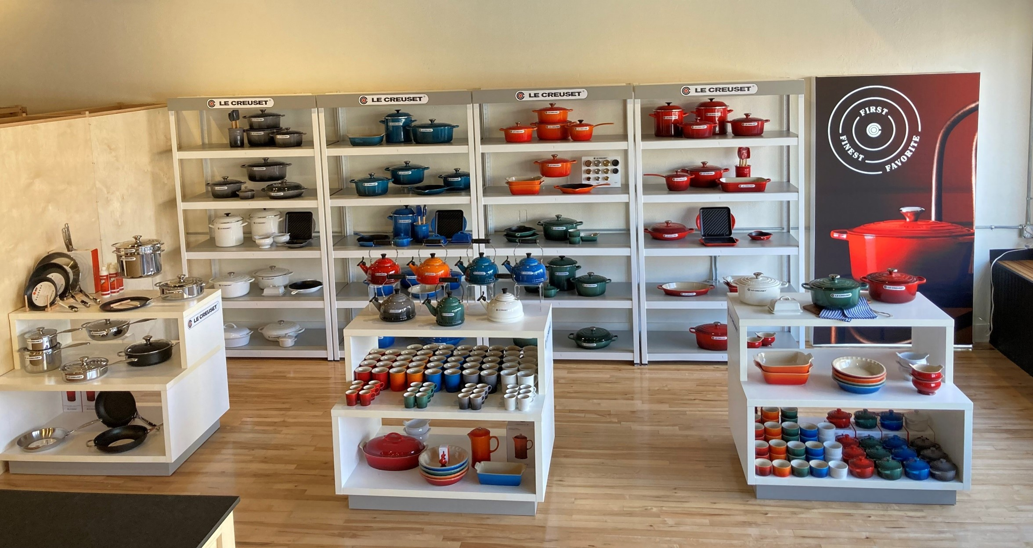
SHOP-IN-SHOP: AROME – SPRING 2022: After

Slide 14
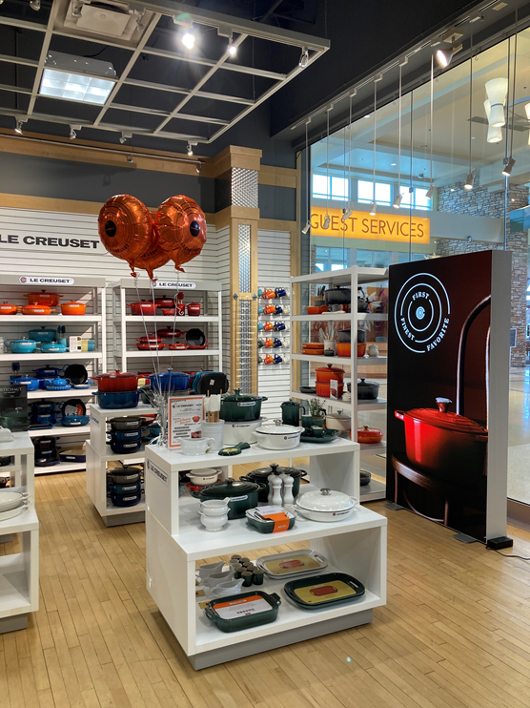
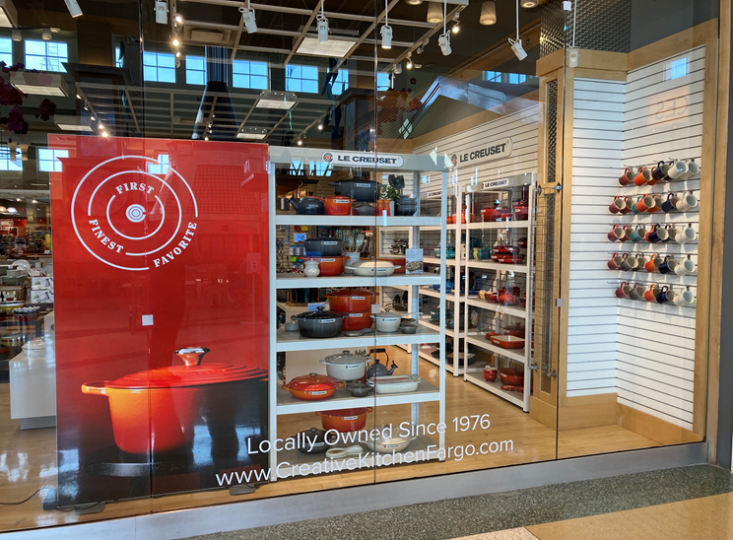
PREMIUM MERCHANDISING PROGRAM BENEFITS
Retailer Benefits:
Increased traffic with enhanced Le Creuset Brand exposure (premium brand destination)
Premium branded components:
Branded Fixtures (min. 4 short and 4 tall)
$10,000 value
Graphics/Lightbox (updated and interchangeable)
$3,000 value
Merchandising kits to support new color/item launches
Exclusive services:
Certified Le Creuset visual merchandising consultation
$1,000 value
Strategic marketing support, tools and training
LC Social Media shared exposure
Total estimated value: $15,000

Slide 15
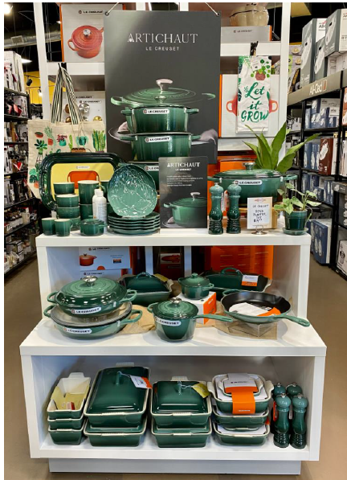
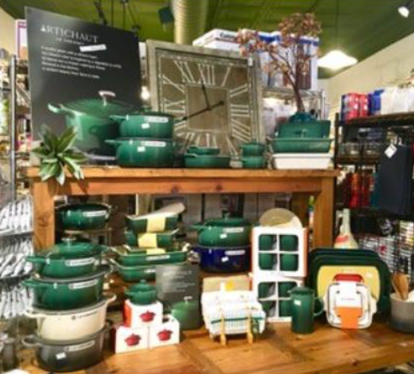
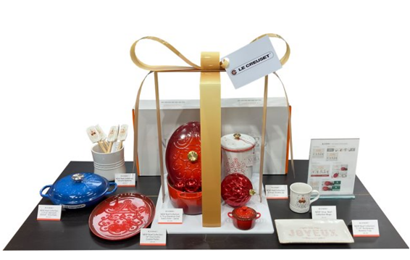
STRONG RETAILER PROGRAM SUPPORT: In-Store Merchandising

Slide 16
MERCHANDISING GUIDE
Purpose
To provide the Wholesale sales team and retail partners with merchandising guidelines and supporting visual materials to ensure the brand is merchandised to brand standards in-store & online to gain premium store placement while increasing sell through.
Guide Components
Merchandising Suggestions for Locations within a store (LC Premium Merchandiser, Wall Bay, Metro Rack, etc.)
Merchandising Tips & Tricks
List of Sales Materials available
Photo Gallery of Best-in-Class Merchandising by Independent Gourmet retailers
Merchandising Guide available via this link: www.lecreuset.com/merchguide

Slide 17
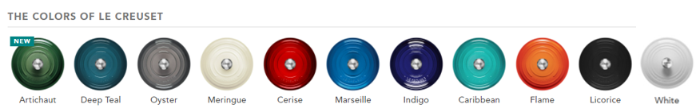
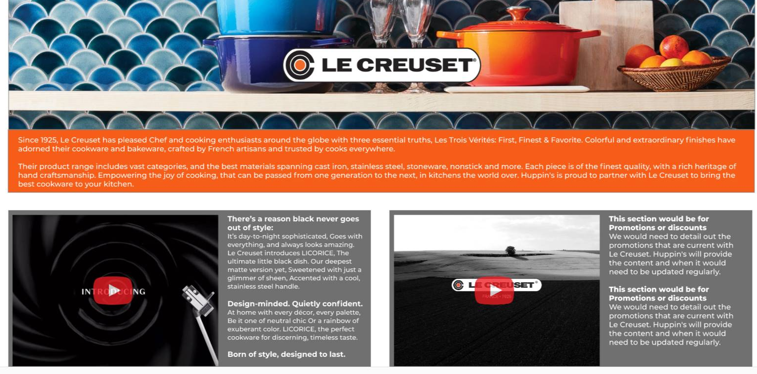
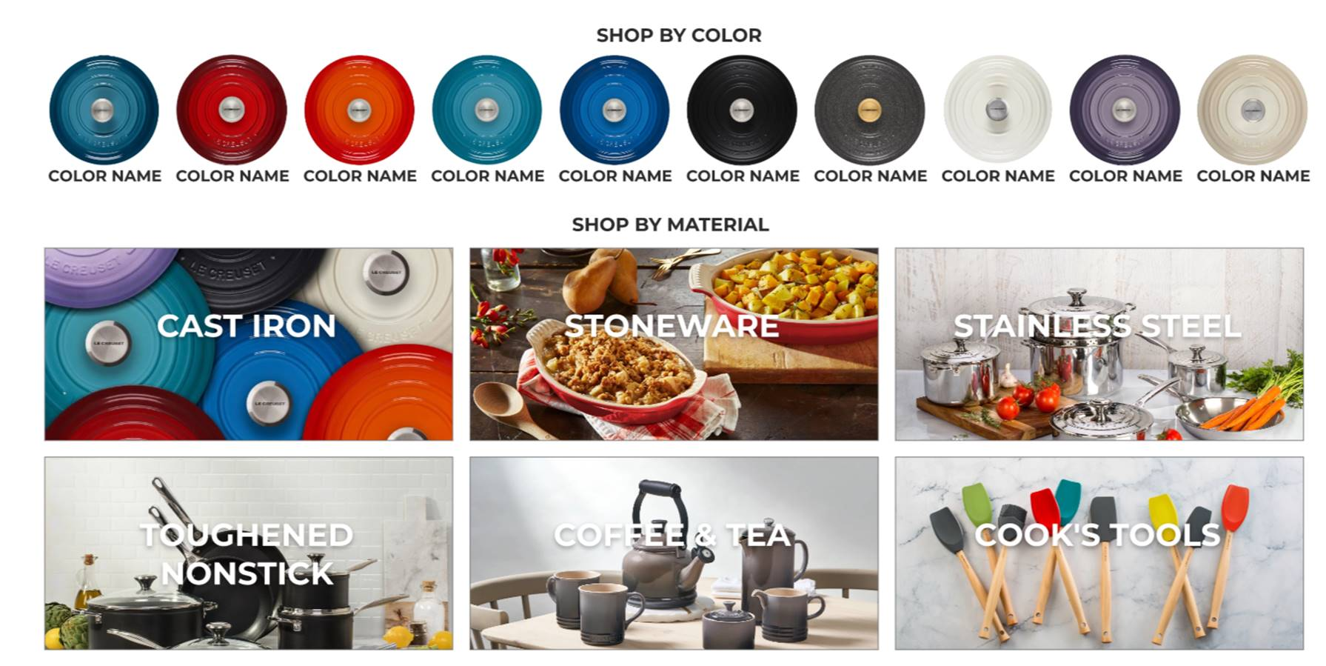
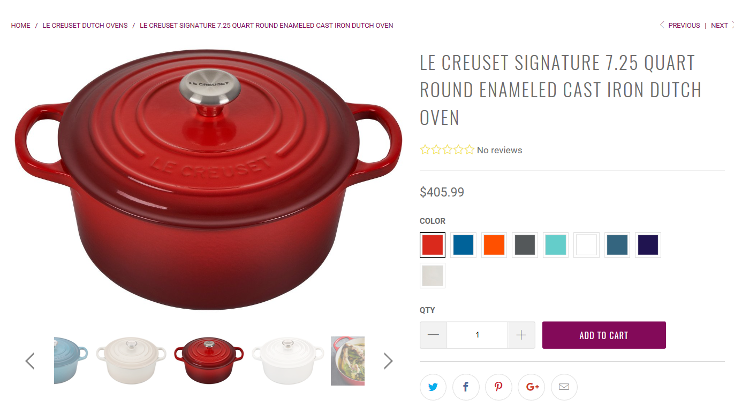
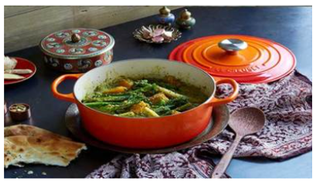


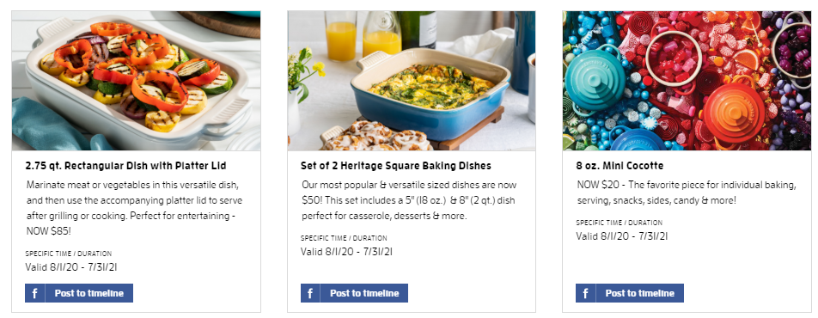
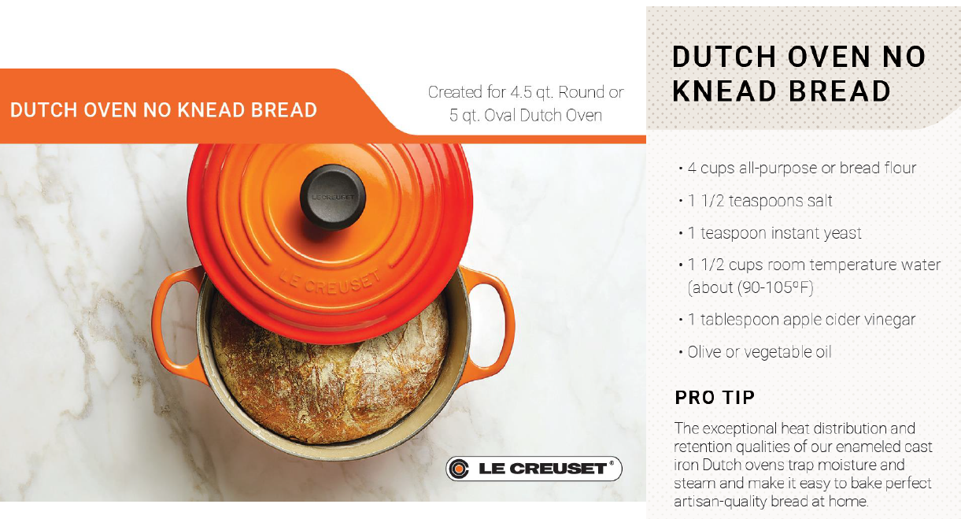

CLICKS: Enhancing On-line Experience and Media Engagement
Brand Pages (Story):
Shop By Brand, Color and Category:
Lifestyle Imagery, Banners, Recipes, and Videos:
Digital & Social Media
Email Content, Facebook, Instagram, Twitter
(The Social Press Kit)

Slide 18
GOURMET CATALOG – SPECIALTY STORE PROGRAMS

Slide 19
CREATE MY PLACE PARTNERSHIP

Slide 20
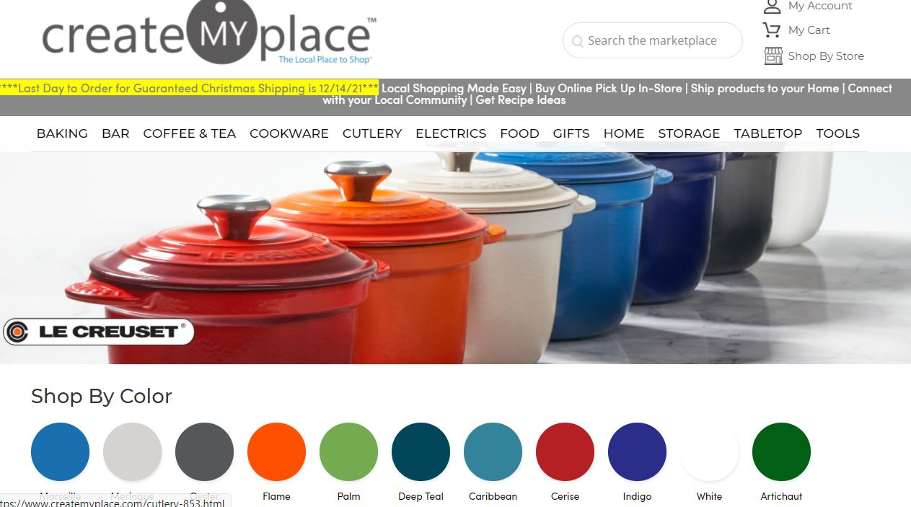
CREATE MY PLACE: BRAND STORE LANDING PAGE

Slide 21
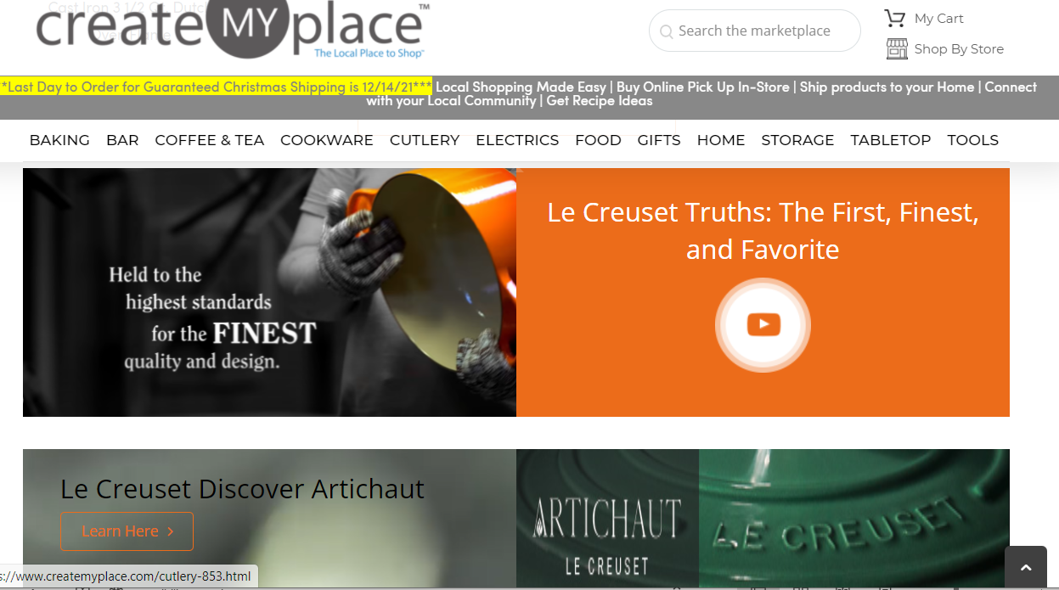
CREATE MY PLACE BRAND STORE LANDING PAGE: VIDEO

Slide 22
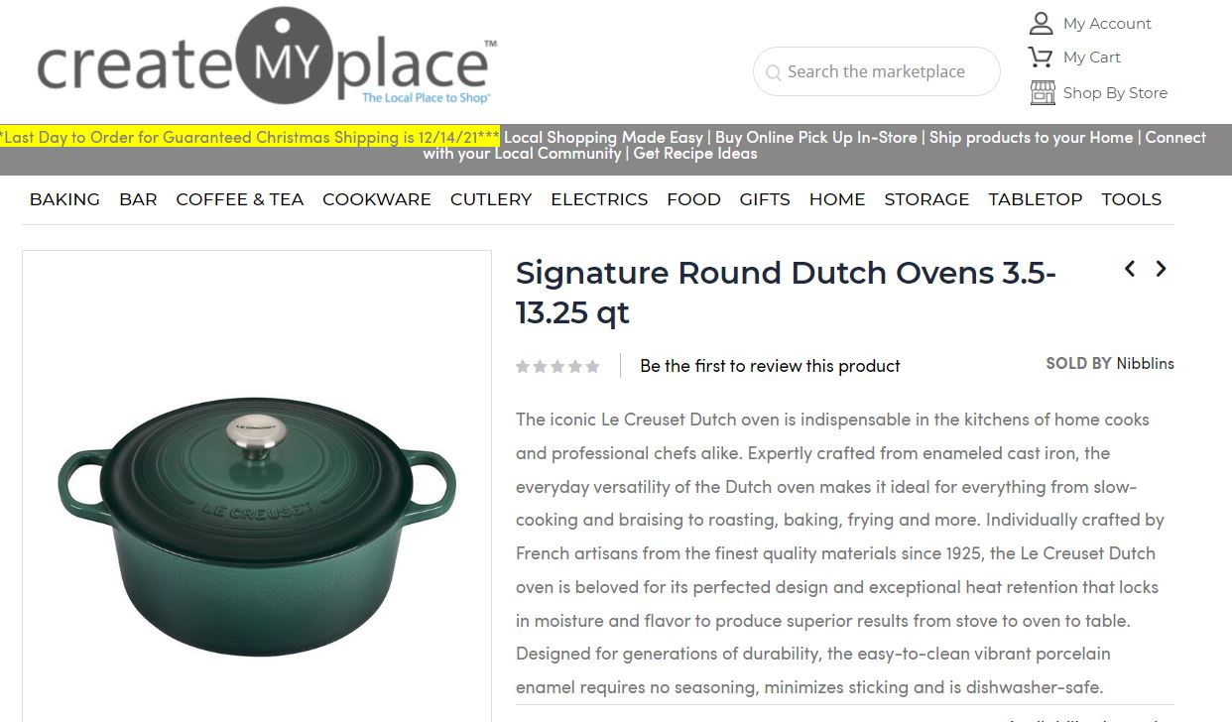
CREATE MY PLACE: PRODUCT DETAIL PAGE

Slide 23
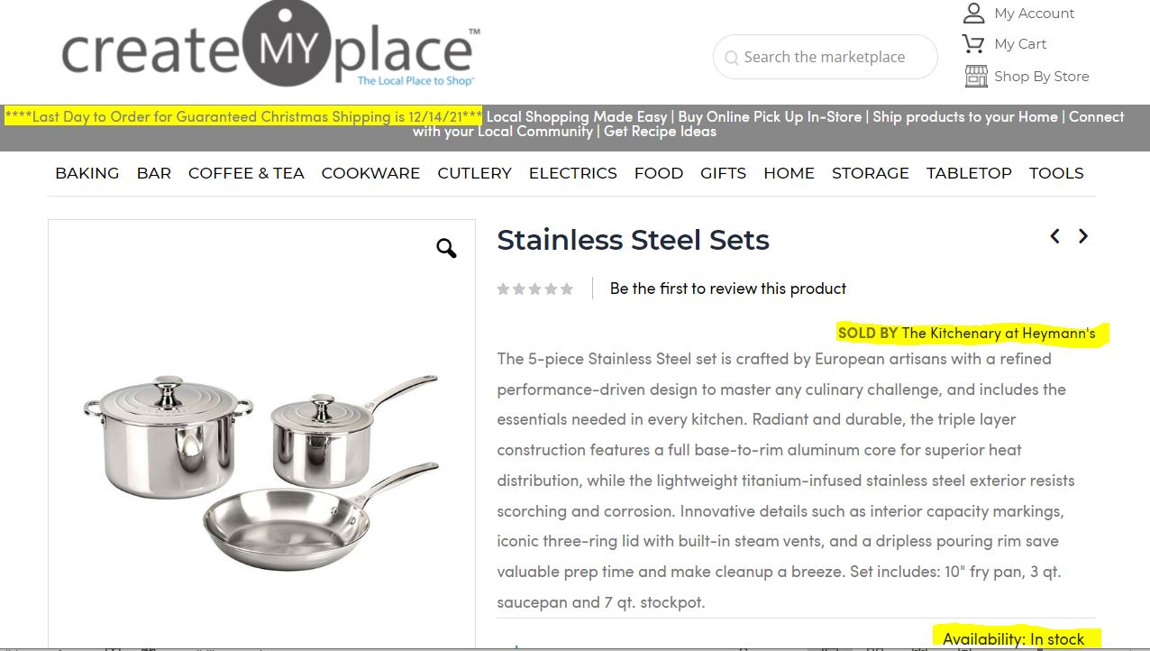
CREATE MY PLACE: PRODUCT DETAIL PAGE

Slide 24
SPECIALTY STORE PROGRAMS

Slide 25

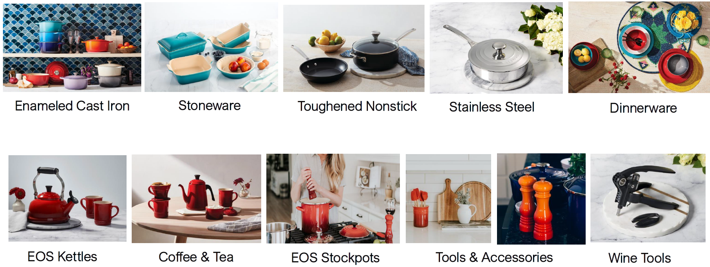
2022 PREFERRED DEALER PROGRAM
2022 PREFERRED DEALER PROGRAM
 | STATUS ACHIEVED
REQUIREMENTS | STANDARD (No Status) | CLASSIC | HERITAGE | SIGNATURE
Independent Retailer - Purchases in Calendar Year 2021 (Jan-Dec) | < $15,000 | $15,000 - $29,999 | $30,000 - $49,999 | > $50,000
Assorted Product (Categories/Skus/Colors) | 5/5/5 | 5/5/5 | 5/5/5 | 5/5/5
Maintained good credit standing and MMAP compliance in 2021 | X | X | X | X
BENEFITS
*Annual Purchase Rebate | 0.0% | 2.0% | 3.0% | 4.0%
Order Dating – Terms | 30 days | 60 days | 75 days | 90 days
Prepaid Freight Eligible (Order Minimum) | $1,200 | $1,000 | $850 | $700
Bonus Free Goods Participation | • | • | • | •
Merchandising Support (POP, Signage, Collateral, Recipes, etc.) | • | • | • | •
Digital Marketing - Full Access to Le Creuset Asset Library and Social Press Kit | • | • | • | •
Store Location Listed on Le Creuset Website ("Where to Buy") |  | • | • | •
+Access to Special Order Program |  | 2/year | 4/year | 6/year
*2021 Purchase Rebate % will be accrued on ALL orders shipped February-December (January “Last Call” not included) and will be issued as a lump sum credit at the end of the year
+ Program available to continental U.S. customers only (excludes Hawaii & Alaska). Shipped to (1) location with FREE FREIGHT; subject to actual shipping charges if expedited shipping is requested (plus $8.50 handling charge).
Independent Retailer does not include accounts who transact >50% of their sales on-line (Web)
Notes:
Idea - We would like to address all Signature accounts separately at Housewares to honor their Signature Status
How many years as Signature? Award engraved Flame Lid?

Slide 26

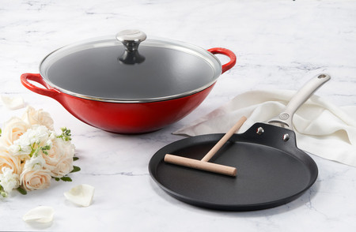
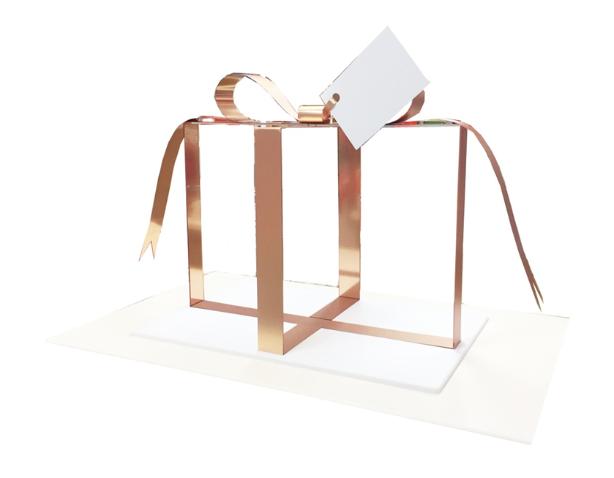
2022 GIFT WITH REGISTRY & COMPLETION PROGRAMS: EFFECTIVE JANUARY 1, 2022
Gift with Registry Offer:
6” White Cast Iron Heart Skillet ($100 value)
Register for $500+ worth of Le Creuset product, and you are eligible to receive the 6” Cast Iron Heart Skillet ($100 value).
Gift with Completion Offers:
Tier I: TNS Pro 11" Crepe Pan with Rateau ($100 value)
Register and receive $500+ worth of Le Creuset product, and you are eligible to receive the TNS Pro 11” Crepe Pan with Rateau ($100 value).
Tier II: Cerise Cast Iron Signature Wok ($300 value)
Register and receive $1,500+ worth of Le Creuset product, and you are eligible to receive both the TNS Pro 11” Crepe Pan with Rateau ($100 value) and 5 qt. Enameled Cast Iron Signature Wok ($300 value).
NEW Registry assets now available on the asset library
Registry Story utilizing the gold box prop - Using the white cast iron and stoneware (maybe some SS) I suggest creating a collection and featuring the NEW Flower Cocotte and Herb Planter.
20 units On-hand

Slide 27
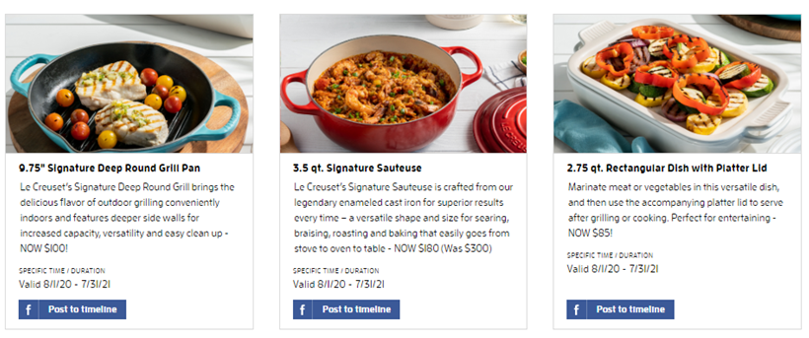

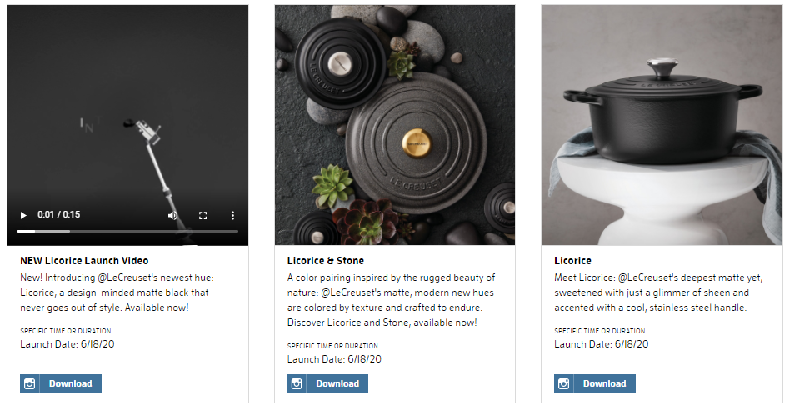
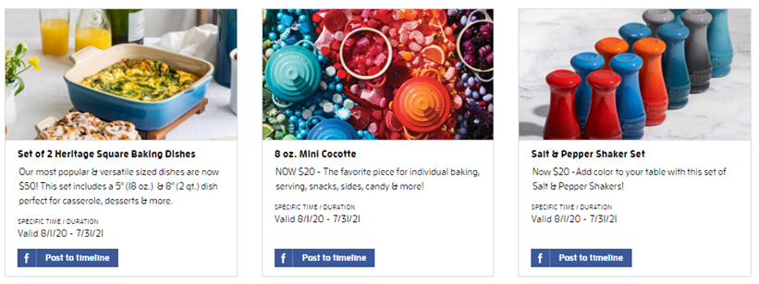
THE SOCIAL PRESS KIT: MEDIA POSTS
Provides our retail partners with at-the-ready (turnkey) social media content and messaging
Consistent brand imagery and communication across the most popular social platforms
Scalable, editable, and flexible to support any and all Le Creuset campaigns

Slide 28
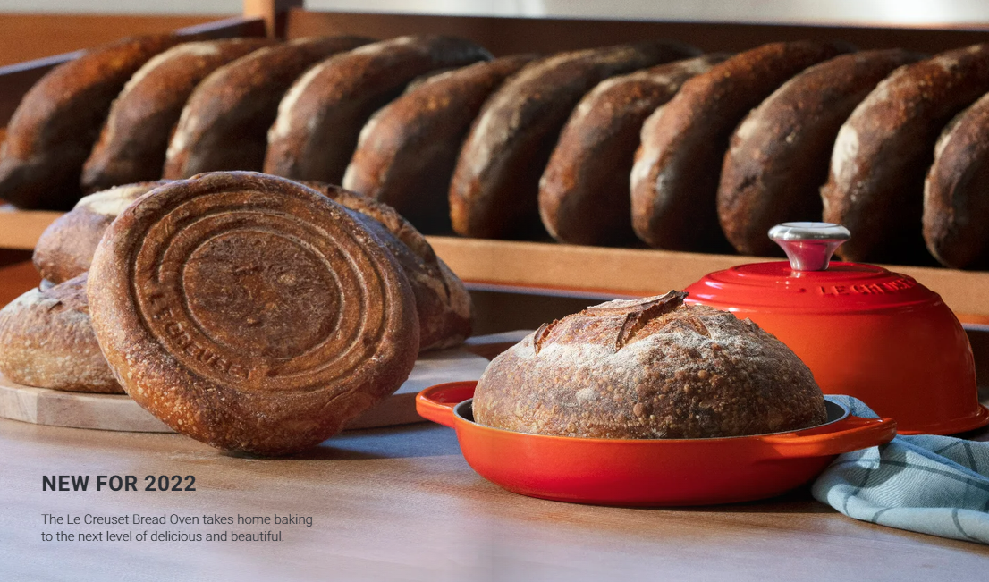
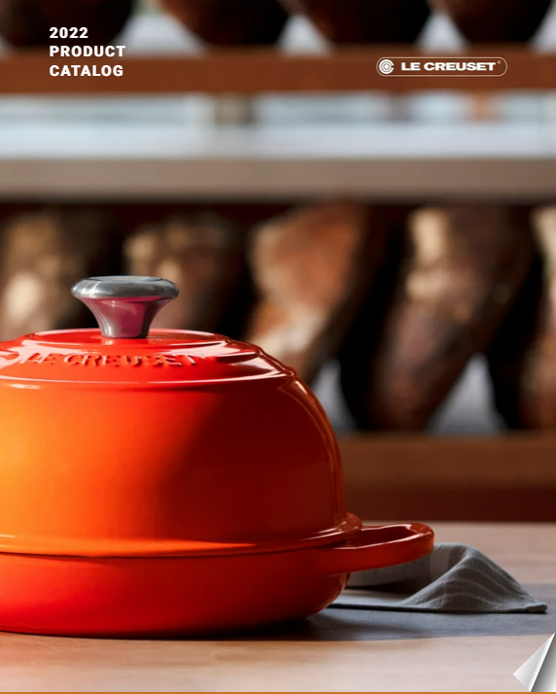
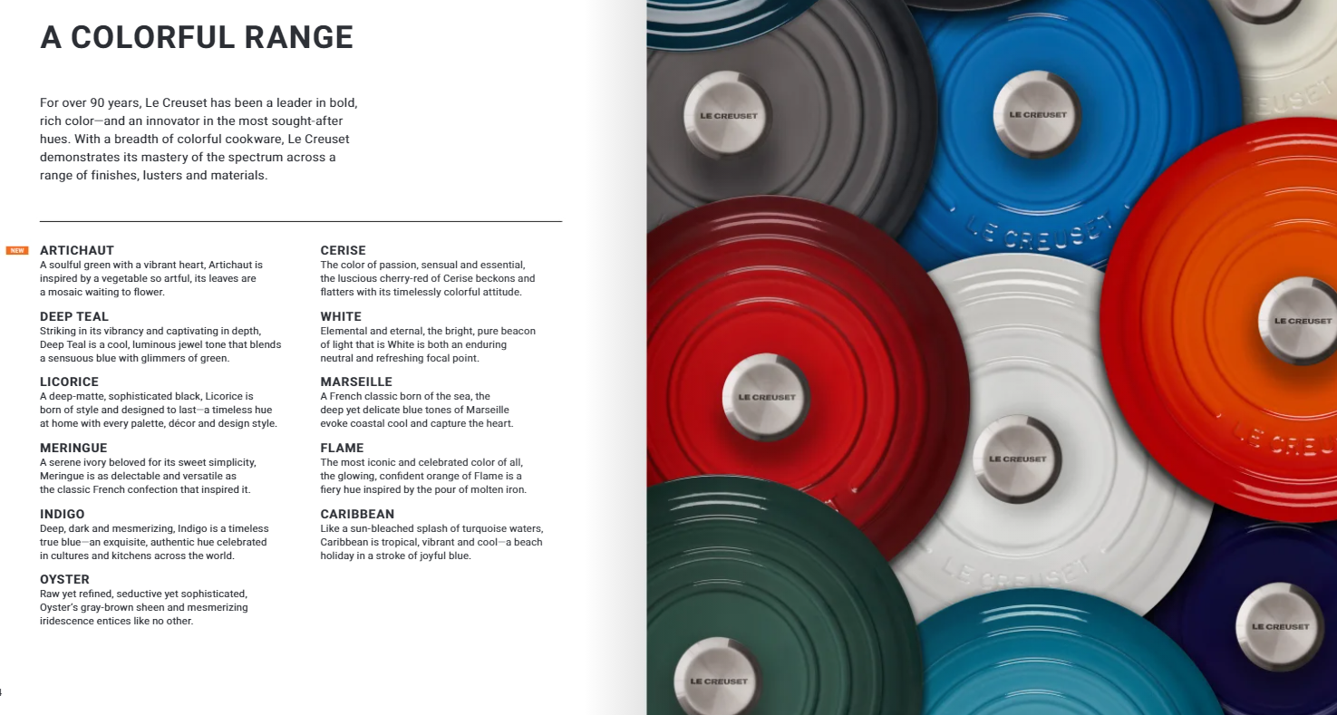
UPDATED 2022 DIGITAL PRODUCT CATALOG
Updated and available at lecreuset.com/productcatalog – access from anywhere on any device with internet connection!

Slide 29
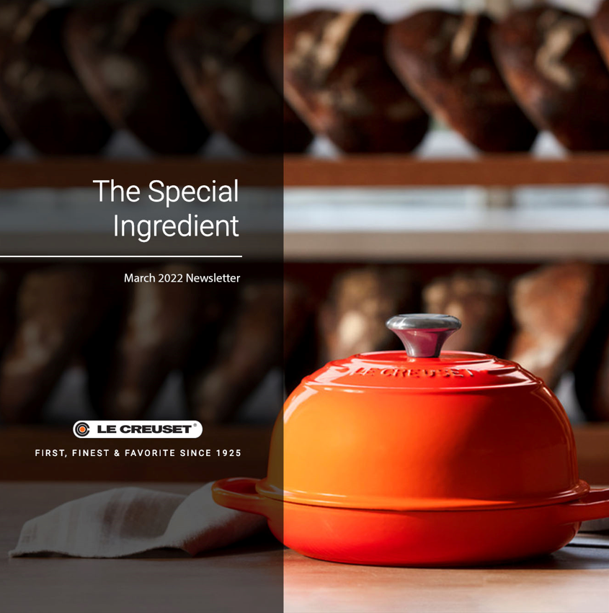
THE SPECIAL INGREDIENT – MONTLY E-NEWSLETTER
Visit each month’s edition of the newsletter by visiting (posted on the 8th): www.lecreuset.com/thespecialingredient

Slide 30
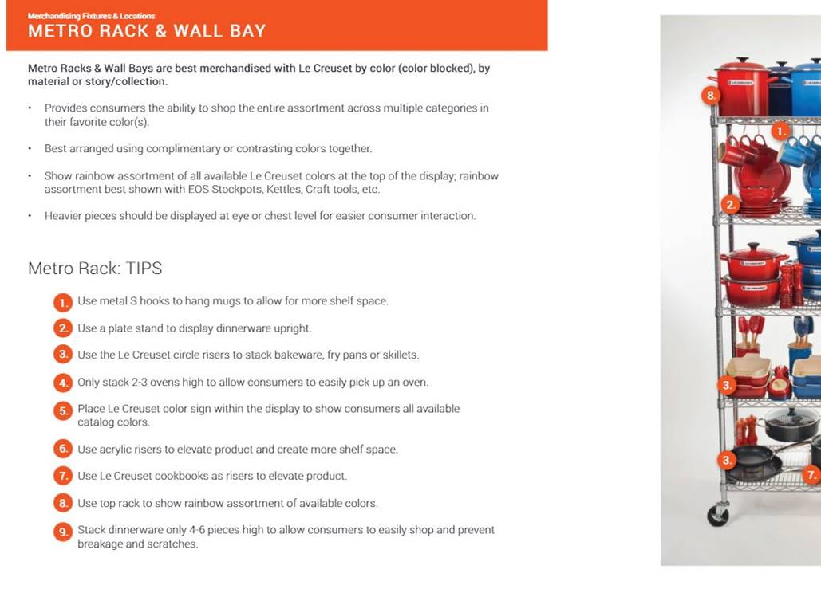
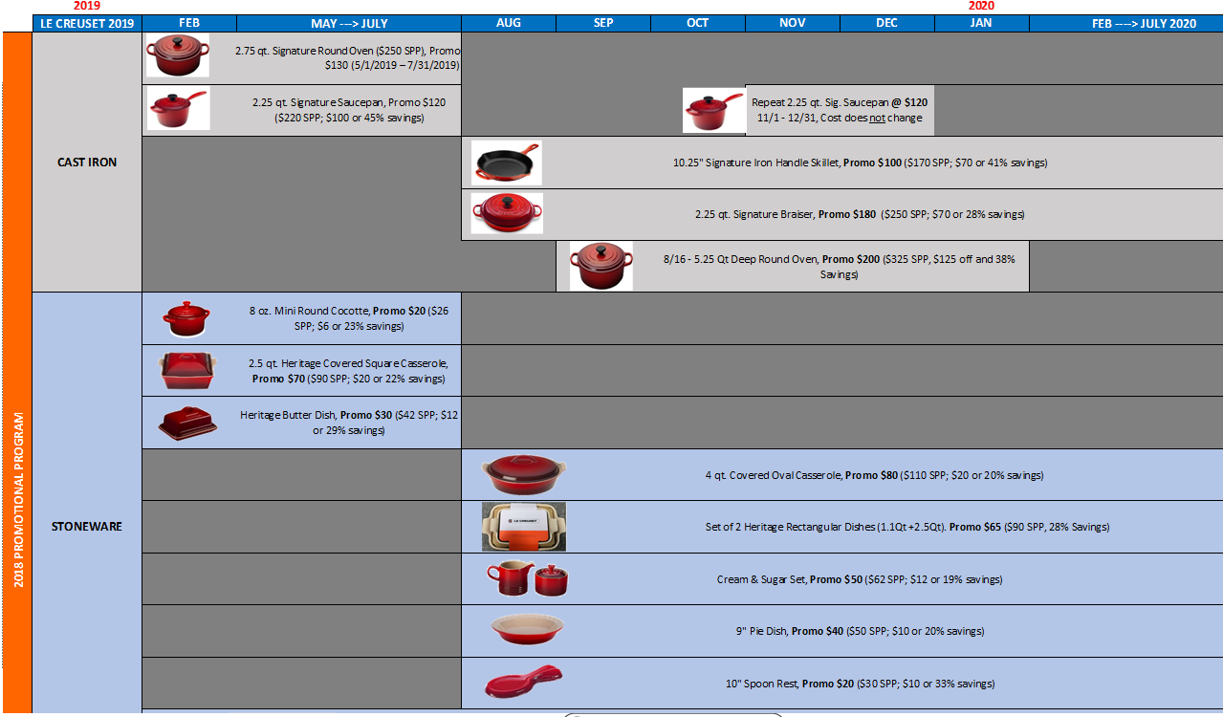
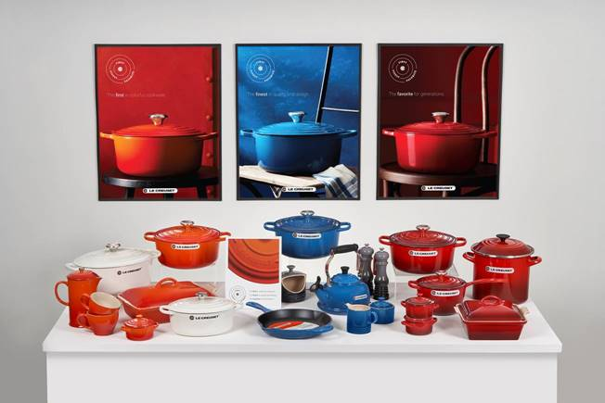
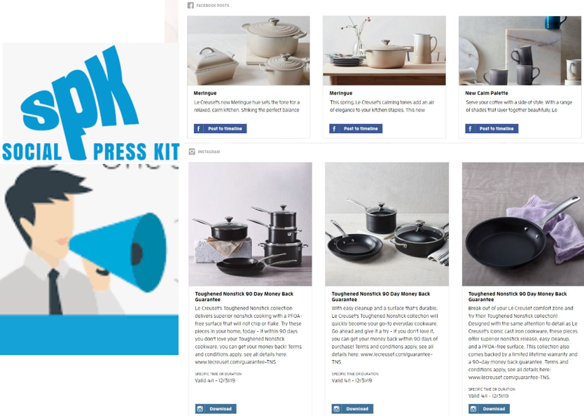
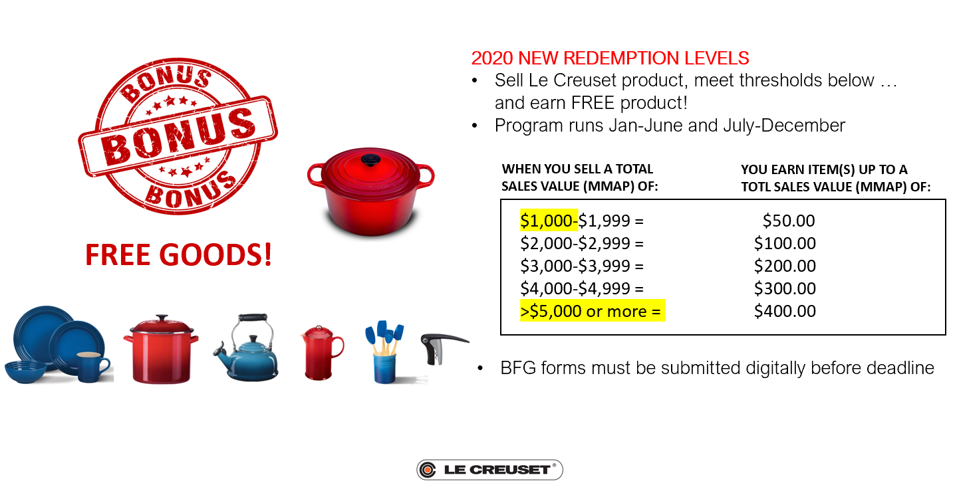
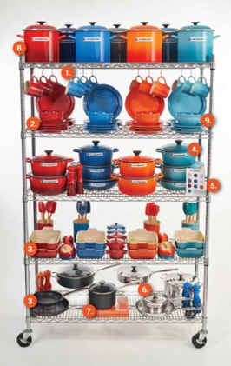
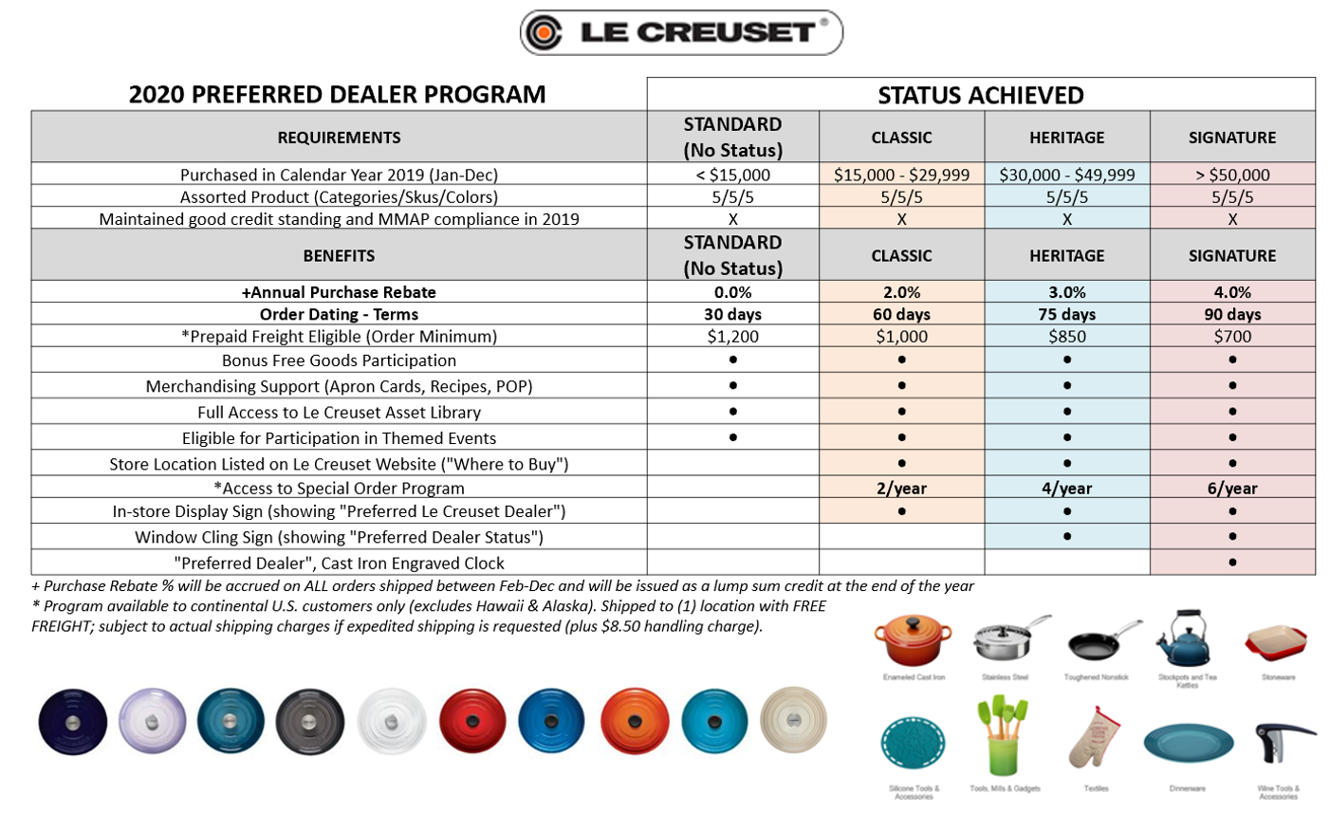
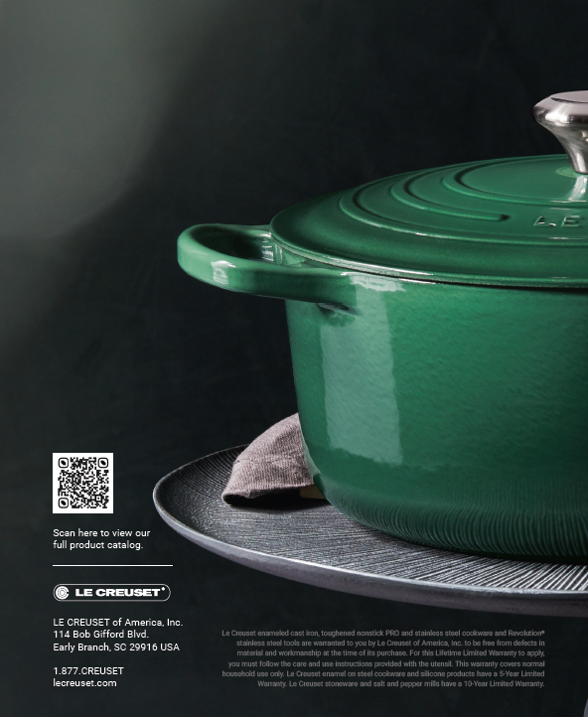









LE CREUSET ADDITIONAL SUPPORT PROGRAMS AND SALES TOOLS
Helping our partners become better Le Creuset Retailers… ask your Sales Manager for more details!
MERCHANDISING GUIDE
PROMOTIONAL DASHBOARD
MERCHANIDSING KITS
SOCIAL PRESS KIT
BONUS FREE GOODS
MERCHANDISING GUIDE
PREFERRED DEALER PROGRAM
DIGITAL PRODUCT CATALOG & CONSUMER BROCHURE
BUNDLES & GWPs
FIXTURES
TRAINING PLATFORM
THE SPECIAL INGREDIENT
GIFT WITH COMPLETION (GWC)
BEST SELLER LIST
ASSET LIBRARY
CULINARY DEMOs AND EVENTS (TRUNK SHOWS)

Slide 31
PRODUCT CATEGORY UPDATES

Slide 32
2nd HALF PLANNER and ACTIVITY SUMMARY

Slide 33

REGIONAL SHOW SPECIAL – BUY-IN PROGRAM
Show Special (below): 5% off on >$5,000 order with Fall Dating terms
Order can include new items like Bread Oven Colors, Oil & Vinegar, 9” Skillet Special, Olive Branch, etc. launching 8/1)
Show Special Buy-in: | TIER I
Total Order Value, Net Dollar Amount (*Orders placed between 6.15.22 – 7.15.22) | ˃ $5,000
*Minimum Payment Terms | Fall Dating (12/1)
Discount applies to entire order when tier criteria is met. | 5% OFF
Prepaid Freight (FREE) | X
Digital Marketing and Social Media Assets (SPK) | X
Campaign ID: SSS22

Slide 34
EIFFEL TOWER
July 14th, 2022

Slide 35





EIFFEL TOWER COLLECTION, LAUNCHING 7/14!

Slide 36










EIFFEL TOWER COLLECTION
CHANNEL: Full Price
LAUNCH: 7/14/2022
(Bastille Day)
CERISE
WHITE
INDIGO
Product | 3.5 qt. Signature Braiser- Gold Knob | 2.5 QT Signature Cocotte- Gold Knob | 2.75 QT Covered Sq. Casserole | 9" Pie Dish | 14oz Mug | 8oz Mini Cocotte | 3.5qt Covered Rectangular Casserole
Material | Cast Iron | Cast Iron | Stoneware | Stoneware | Stoneware | Stoneware | Stoneware
Color | Cerise / Indigo / White | Cerise / Indigo / White | Cerise/ Indigo / White | Cerise / Indigo / White | Cerise/ Indigo / White | Cerise/ Indigo / White | White
Target SRP | $370 | $220 | $110 | $55 | $22 | $31 | $120
Item # | LS2532-30XXETSG | LS2184-22xxETSG | PG6118E-275 | PG6109E-09 | PG90033AE-00 | PG1160E-0867 | PG1148S3AE-32
Notes:
Mini cocottes ($31/ $20) and rectangular covered casserole ($120) are on reorder for 2022

Slide 37
NEW 2022 COLOR LAUNCH
National Launch Date: 9/1/2022

Slide 38

SEA SALT
A serenely beautiful tone –
Inspired by the sea’s most treasured mineral.
SEA SALT is an elemental pinch of flavor,
Ready to enrich any décor,
Enhance any taste
With nuanced subtlety and style.
Let it season a neutral palette,
Be a balm to bolder hues.
Or stand alone with its gentle spirit,
An eternal gift from the sea,
To your table, your home.
SEA SALT by Le Creuset

Slide 39






SEA SALT NATIONAL LAUNCH 9/1/2022

Slide 40

SEA SALT NATIONAL LAUNCH: TRAFFIC BUILDING AND VISUAL SUPPORT
NATIONAL LAUNCH SEPTEMBER 1, 2022
Launch Kit Materials
Table Sign (8.5X11 with base)
Poster (22"x28“)
Ala cart traffic drivers:
Social JPGS
Direct Mail templates
Email templates
Billboard templates
Digital ad template
ROP ad template
Merchandising Guide
FPO
FPO
FPO

Slide 41


SEA SALT BUY-IN PROGRAM
Sea Salt Buy In:
Orders placed 7/15 – 8/15 (shipments begin 8/1 for 9/1 National Launch)
Can include buy-in for new September launch items (*in the color Sea Salt) - Pumpkins, 9” Skillet, 5.25 qt Deep, and Olive Branch, etc.
Sea Salt Order Value, Net Dollar Amount (*Orders placed between 7.15.22 – 8.15.22) | $3,000 - $4,999 | ˃ $5,000
*Minimum Payment Terms | Fall Dating (12/1) | Fall Dating (12/1)
Discount (applies to entire order when tier criteria is met) | None | 5% OFF
*2 Qt. Signature Round Casserole (Cerise) | X | X
Prepaid Freight (FREE) | X | X
Merchandising Kit & Digital Marketing Assets | X | X
The Social Press Kit w/ Social Media Assets | X | X
*Tier I & II Free Gift With Purchase:
4 FREE Signature Cerise 2Qt Covered Round Casserole, Model PG0562S3A-2467 ($360 value)
*Max 4 per order
Campaign ID: SSLP22

Slide 42

2H 2022 GWO OFFER: DRIVE INCREASE IN AVERAGE ORDER VALUE
PRODUCT NAME: Signature 2 qt. Covered Round Casserole
SKU: PG0562S3A-2467
COLOR: Cerise
VALUE: $90
PRODUCT FEATURES
24cm diameter, 2 qt. Capacity
Secure-fitting stoneware lid with round knob traps in heat and moisture
Dishwasher-safe; oven-safe up to 500 degrees F
Perfect for casseroles, side dishes, and desserts
Resistant to staining and flavor/odor absorption
Program Calendar:
July- August
Sea Salt Buy In: Orders placed 7/15 – 8/15 (shipments begin 8/1 for 9/1 National Launch) orders can be written in June/July at shows
September- January 2023 (While supplies last)
All orders over $3K

Slide 43
SEASONAL PROGRAMS & COLLECTIONS

Slide 44
NEW OLIVE BRANCH EMBOSSED COLLECTION
Collection Launch Date: 8/1/2022

Slide 45


Slide 46







OLIVE BRANCH COLLECTION
LAUNCH: 8/1/2022​
IMAGE |  |  | ​
SHAPE​ | 3.5 qt. Signature Braiser | 5.25 qt. Signature Soup Pot | 4 qt. Heritage Covered Rectangular Casserole | 20 oz. Oil Cruet
MATERIAL​ | Cast Iron​ | Cast Iron | Stoneware​ | Stoneware
NATIONAL COLORS | Marseille, Indigo | Artichaut | Marseille, Indigo & Artichaut | Marseille, Indigo & Artichaut
SKU | LS2532-30xxOB​ | LS2514-28795OB | PG07053AOB-33 | PG1300OB-20
SRP | $370 | $320 | $130 | $50

Slide 47
NEW AUTUMN PUMPKIN COLLECTION
Collection Launch Date: 9/1/2022

Slide 48






AUTUMN PUMPKINS
LAUNCH: 9/1/2022​
ETA to EB: 7/1/2022​* (*Varies by SKU & color)
IMAGE​ | ​ | ​
SHAPE​ | Pumpkin Cocotte | Pumpkin Baker | Pumpkin Mini Cocotte
MATERIAL​ | Cast Iron​ | Stoneware​ | Stoneware
SIZE | 4 qt. | 9” | 350ml
COLOR | Persimmon, Meringue & Sea Salt | Persimmon, Meringue, Sea Salt, Cotton | Persimmon, Meringue, Sea Salt
SKU | LS2138-24XXSS | PG4161-23XX | PG4160-10XX
SRP​ | $350 | $120 | $30
PERSIMMON
MERINGUE
SEA SALT

Slide 49
NOEL COLLECTION – 6 NEW SKU’s!
Collection Launch Date: 10/1/2022

Slide 50








NOEL: 2021 CARRY FORWARD SKUS
IMAGE​
SHAPE​ | 2.25qt. Signature Braiser w/ Snowflake Embossed | Oval Santa Platter | Rectangular Hostess Tray | 14 oz. Mug 5 styles | Santa Spatulas
MATERIAL​ | Cast Iron | Stoneware | Stoneware | Stoneware | Tools
COLOR | Marseille | Cerise | White | White | White
ITEM # | LS2532-2659NSS | PG2020N-1467 | PG2021N-2816 | PG9003N-XXXX | JS410-16NC20 JS410-16NC21
SRP ​ | $295 | $75 | $50 | $22 each | $13

Slide 51






NOEL: 2022 NEW ASSORTMENT ADDITIONS
LAUNCH: 10/1/2022
ETA to EB: 8/1/2022
IMAGE​
SHAPE​ | 4.5 qt Signature RDO Embossed | Figural Spoon Rest | Utensil Crock Set | Mug Reindeer Applique | XL Joyeux Mug Applique | Whistling Kettle
MATERIAL​ | Cast Iron | Stoneware | Tools | Stoneware | Stoneware | EOS
COLOR | Artichaut | Artichaut | Cerise crock, White silicone | White | White | White
SKU | TBD | PG8114-14795 | JS4502-67 | PG9003N-0716 | PG8030-2016 | Q3101N-16
SRP​ | $390 | $35 | $84 | $22 | $35 | $130
Notes:
STATUS: NEW LIMITED LIFE

Slide 52

THANK YOU!

